Slide 1
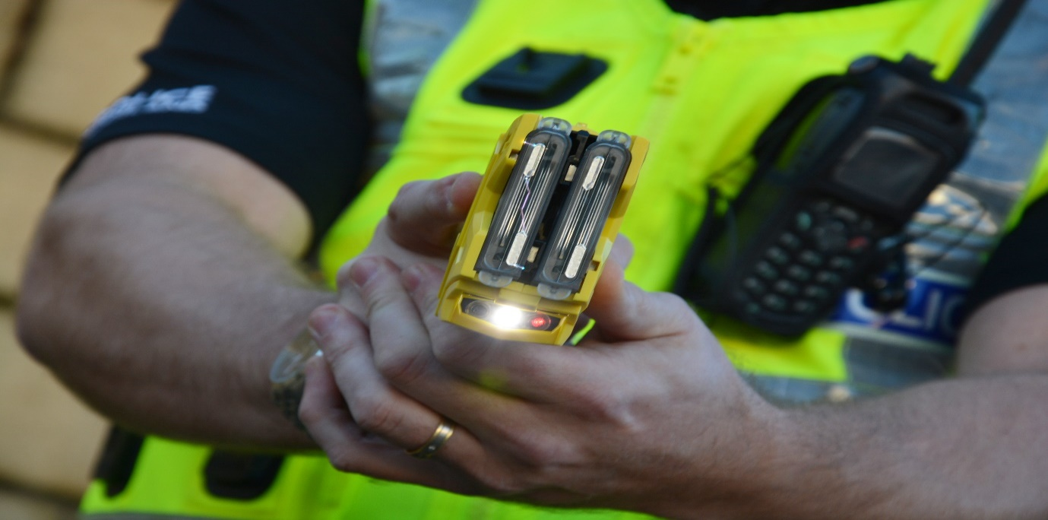
Taser – Public Briefing
Briefing No. 19
September 2024

Slide 2
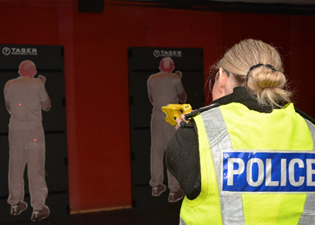
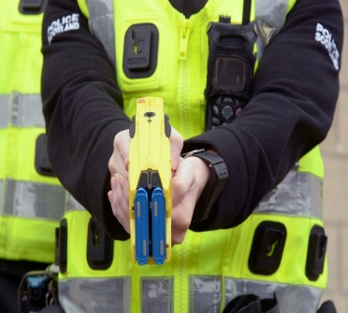
Summary
This briefing provides information on the carriage and operational deployment of Conducted Energy Devices (Taser) by Police Scotland. It also details how Police Scotland have increased the number of number of Specially Trained Officers (STOs) to enhance capacity across the country since the Taser Operating Model was considered at the SPA’s Policing Performance Committee in September 2021.
What are Tasers?
Taser is commonly used brand name of the Conducted Energy Devices that are currently used by Police forces across the UK. Tasers can be used in a number of progressive ways to de-escalate a potentially violent or dangerous situation whilst limiting and controlling the proportionate use of force.
A Taser is designed to provide frontline Officers with the ability to restrain potentially dangerous individuals and reduce the potential of threat or harm to themselves or to other individuals. Tactics available include the removal of the Taser from its holster, drawing, the aiming of the Taser, red dotting and finally if required the discharge of the Taser.
Tasers have been in use by Police Forces in the UK since 2004 and research shows that in 85% of Taser use, the tactic has stopped at drawing or red dotting and the situation controlled without the necessity for the Taser to be discharged.
Officers attending an incident, will firstly use verbal communication skills to de-escalate the situation, ongoing dynamic assessment will be applied and resorting to Taser tactics will only be used when there is an immediate threat or risk of harm.
The device generates short bursts of electricity and delivers brief pulses upon contact, immobilising the person which significantly reduces injury risk to both the individual and the Officer.
In the UK, a Conducted Energy Device or Taser is classified as a ‘prohibited weapon’ in Section 5 of the Firearms Act 1968 and it is an offence for any member of the public to possess or use such a weapon.
Police Officers whilst acting in their capacity as such, are exempt from the requirements of the legislation.

Slide 3
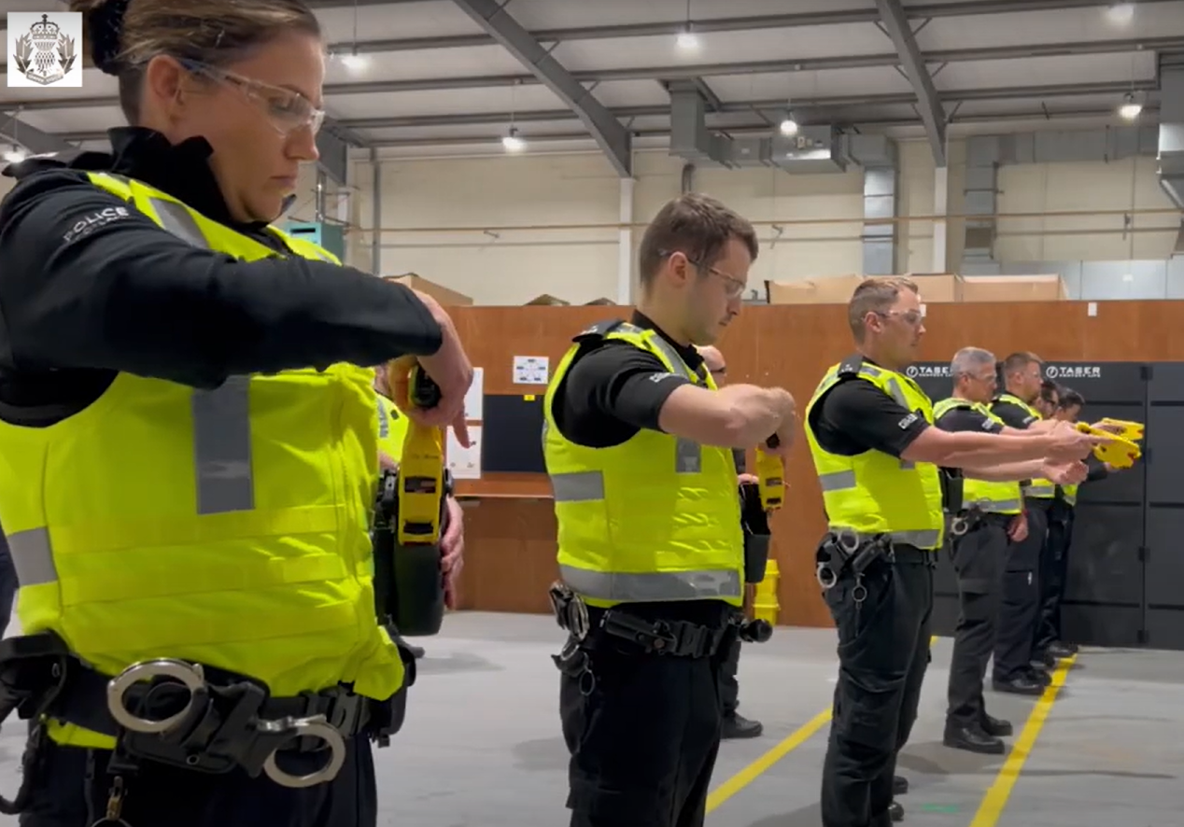
The implementation and the carriage of Tasers by Police Scotland
In 2018 Police Scotland introduced a new group of Specially Trained Officers (STOs) who have been personally qualified to use a Taser device. Having considered the benefits from carrying Taser, Police Scotland developed a proposal for consideration at SPA’s Policing Performance Committee in September 2021 to commence an expansion programme which included enhancing the number of Taser STOs. Since the start of this expansion there are now over 1,500 STOs trained and currently working within Police Scotland. To qualify as a STO and use a Taser, Officers must complete a rigorous training programme which includes not just the use of the device, but the understanding of and skills in a range of de-escalation approaches.
The nature of response policing means that Officers will often have to deal with incidents that are fast moving, dynamic and where information is limited and time is critical. The primary consideration in this situation is the current or emerging threat of harm to either to citizens or to the officers themselves. The actions or potential actions of the individual whose is posing that threat and how to remove that threat are balanced against the potential impact of the application of the Taser tactics on the threatening individual.
Selected, trained and accredited Officers will be deployed as STOs across all 13 Local Policing Divisions under the command of the
Local Policing Commanders, ensuring that each Division has access to a
24 hour Taser capability.
These Officers will be deployed from identified response policing
hubs located across the country to incidents where there is violence
or threats of violence of such severity that the use of a Taser
may be necessary to reduce the immediate risk of threat to citizens or officers.
Qualification as a STO follows successful completion of a 4-day course which involves both theoretical and practical elements. Officers then return once a year for annual refresher training to maintain their STO status.

Slide 4
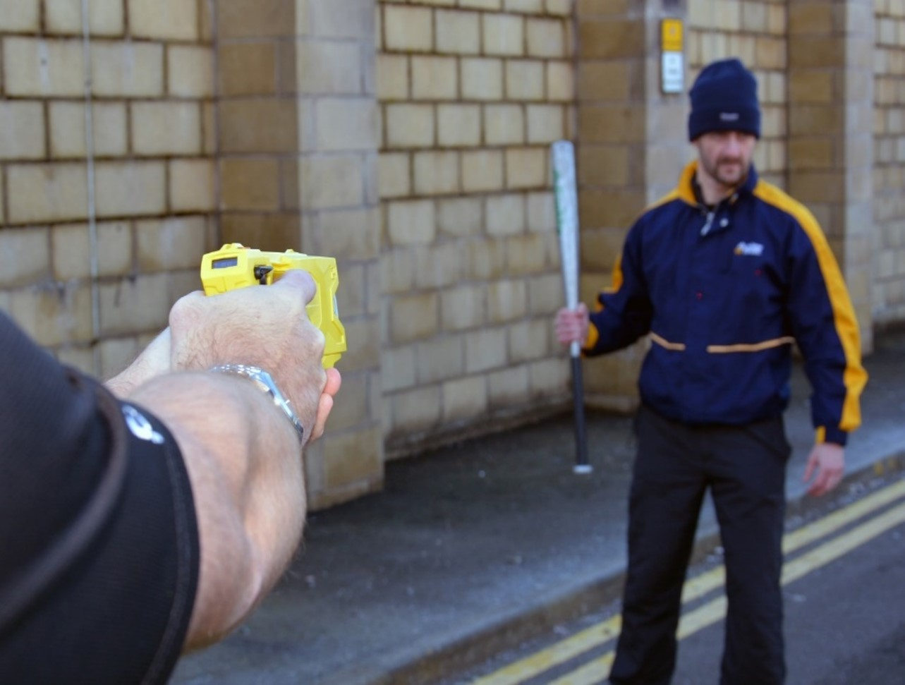
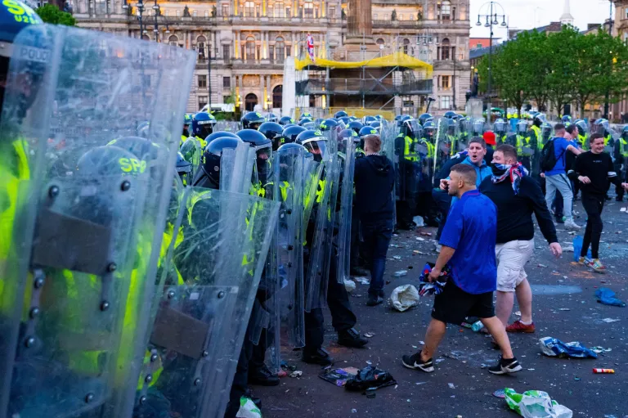
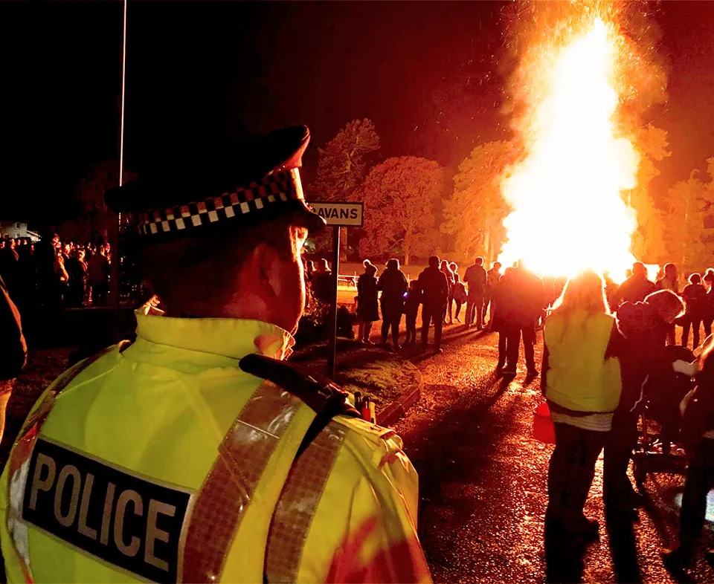
The use of Tasers in policing
Police Scotland has a duty to protect life and to ensure the safety of its Officers and the public. Specially Trained Officers (STOs) carry Taser as one of their options to protect people from violence. When confronting potentially dangerous or violent individuals, frontline Police Officers have a duty to minimise the risk of injury or death to the individual themselves, the immediate community, and other Officers.
Instead of using a baton to control situations where the threat of violence is high, technologies such as a Taser may be used instead. Taser allows the Police Officer to keep that distance and avoid direct physical contact.
Tasers are one of several tactical options that can be used when dealing with an incident that has the potential for conflict.
In Police Scotland, the carrying of Tasers is limited to that of specially trained Police Officers to ensure that its use is proportionate, ethical, transparent, and only used as a method of harm reduction when absolutely necessary.
Any use of force by an Officer must be the minimum amount necessary to accomplish the lawful objective concerned.
It is recognised that a baton may cause injury to a potentially harmful individual, another member of the public or police Officer.
Compared to other uses of force such as PAVA
spray (a safer alternative to pepper spray), baton,
handcuffs or firearms, Tasers are least likely to
cause long-term harm or injury to the subject.
The devices are mainly used to control individuals in incidents where the risk of violence is high. This is done to mitigate any further harm (i.e. injury or death) to that individual, as well as protect bystanders and Police Officers.
The Taser X2 device has been subject of rigorous independent medical testing. It is acknowledged that there is an increased risk to children and persons with a smaller stature and these increased risks are thoroughly covered within Taser training.

Slide 5
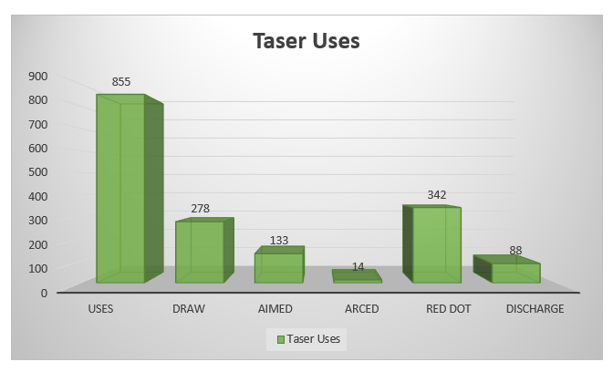
The use of Tasers in policing
Stats provided by NTU, Police Scotland for period 2023-2024
Figures provided for the last year indicate that from the 855 uses, 278 are passive uses (drawn only where the Taser has been removed from the holster as a precaution and then replaced without the need to point at the subject). This equates to 32.5% of uses, when the Taser has not been pointed at the subject
57.2% involved the Taser device being aimed/arced or red-dotted at the subject(s) in question and the remaining 10.3% of uses resulted in the device being discharged.
The flexibility to use these progressive approaches can be used to control a situation whilst minimising the risk of injury and harm. Every time a Taser is discharged by a Police Scotland Officer, a “Use of Force” report is completed which records the need for its use and enables auditing of Taser deployment.
This report is sent to the Police Investigations Review Commissioner (PIRC) for independent scrutiny and potential review. From the 88 discharges during 2023/24, PIRC investigated two that met their criteria for review.
During both investigations the discharges were
assessed by the PIRC to be
necessary, proportionate and justified.

Slide 6
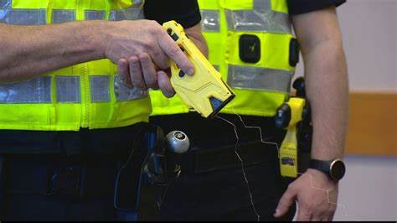
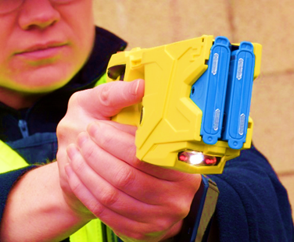
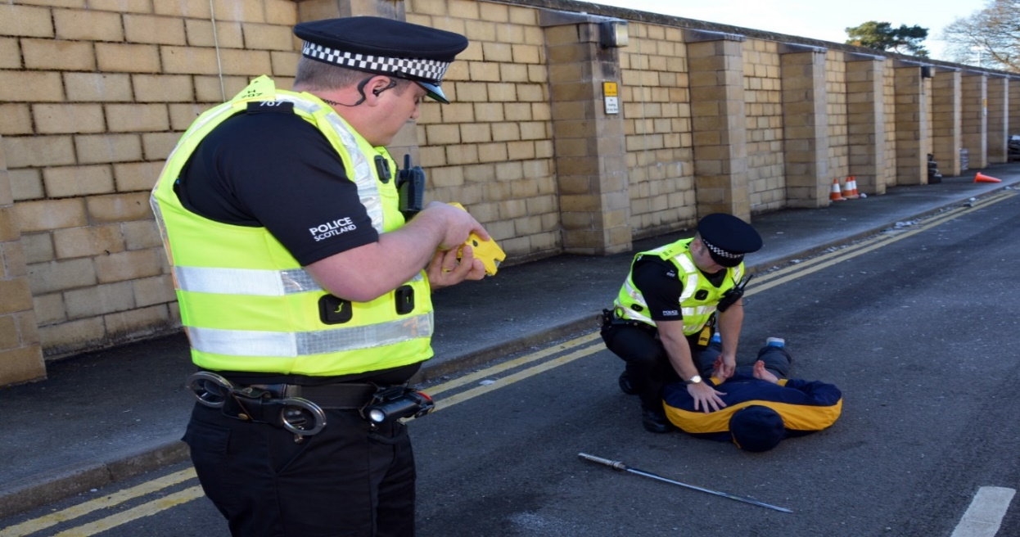
The use of Tasers in policing cont.
The statistics below from the period April 2023 – March 2024 provide an insight into Taser use by STOs across Scotland.
In some incidents there may have been multiple uses of Taser and only one subject.
Analysis by Police Scotland’s National Taser Unit shows that from April 2023 to March 2024, 90% of Taser deployments involved male suspects. 92% of these individuals were aged 18-64.
In 79% of cases Tasers were used to protect officers or threatening individuals and prevent injury. 21% of use was to protect other citizens.
The existing other tactical options such as PAVA spray, handcuffs and batons, although effective in most circumstances, allow limited capability when confronted by subjects armed with bladed or other weapons or when attending potential incidents of extreme physical violence.
The use of Taser is considered a potentially less harmful option, promotes early resolution and can prevent escalation.
“..The ongoing challenges faced by Police Scotland serve as a catalyst for
re-evaluating and reinforcing the protective strategies and tools
available to Officers..”

Slide 7
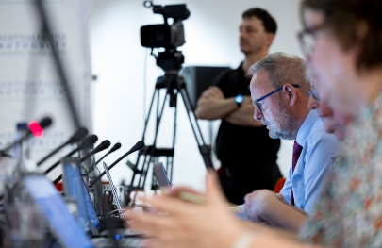
Oversight and assurance
Police Scotland follows the College of Policing’s Code of Practice on Armed Policing and Police use of Less Lethal Weapons. This code of practice lays out the standards and provides clear guidance how Officers throughout the UK utilise Taser devices.
Police Scotland’s Taser Tactical Group maintains an overview and scrutiny of the STOs. Its aims include identifying best practice and looking for opportunities to share learning, in order to maintain and improve the operational impact of Taser use. At a higher level, Police Scotland also has a Taser Monitoring Group which provides strategic oversight of Taser use by frontline Officers.
National research (NPCC) indicates that on 80% of occasions that Officers are presented with violence or potential violence, the mere presence of the Taser is enough to bring that situation to a swift conclusion without the need for any physical force to be used. In Scotland, 88% of incidents are controlled without the requirement to discharge of Taser.
Police Scotland present papers to both the Scottish Police Authority’s Policing Performance Committee and Resources Committee on an ongoing basis.
The Authority’s publication scheme ensures these reports are available to the public with the main aim of improving public understanding of the use of Taser and confidence in the safeguards in place on its use.

Slide 8
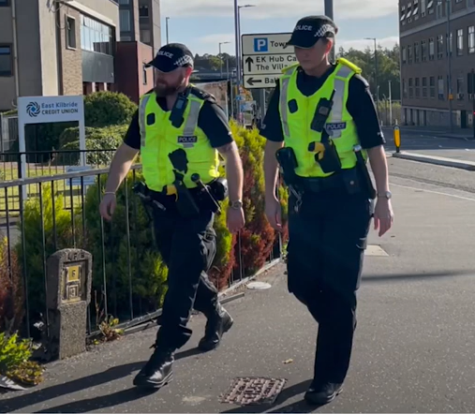
Conclusion and Next Steps
The use of Tasers by Police Scotland Officers provides a progressive and preventative approach to tackling the immediate impact of threat form violent offenders in Scotland. Police Scotland continue to monitor its use by Officers, and the Authority and PIRC will continue to provide oversight, investigation and assurance.
Purpose of the Briefing
The Strategic Police Plan commits to the provision of Policing for a safe, protected and resilient Scotland. This requires designing and maintaining services which are responsive to evolving threats and risks to the safety and wellbeing of our communities. To meet these demands, now and in the future, Scotland’s police service must adapt and proportionately adopt the necessary technologies which will enable them to keep people and places safe.
These public briefings also contribute to the Authority’s statutory function to keep under review the policing of Scotland.
This series of public focused and user-friendly public briefings has been developed to provide an overview of the benefits of emerging technology and upcoming developments within policing, the policies that will govern them, and the ethical, privacy and human rights implications.
Keeping up to date
To keep up to date with our work, please keep an eye on the Scottish Police Authority’s website where you can find more public briefings and factsheets on operational matters, topical issues and technology being used by Police Scotland.
There are also links to watch livestream committee discussions,
and follow us on Twitter/X:
@ScotPolAuth @Policescotland
Date published: September 2024

